Slide 1
Data Integration and Structured Search

Slide 2
RDF – a grammar for Web links
Resource A
Resource
Resource B
Resource
related toy
Resource A
Resource
described byy
Some text
http://dublincore.org/workshops/dc6/pp/miller-datamodel.ppt, 1998
“Related to” and “described by” are “RDF properties”.

Slide 3
RDF – a language for linking data
URIs are the words of the language.
URIs provide global identity independently of application context.
Domain Name system provides global distributed namespace management.
“Follow your nose”: documentation should be available available on the Web through the URIs.

Slide 4
How to create and query linked data
1. Express the data (from various sources) in RDF.
2. Combine the RDF data into one whole.
3. Query the combined whole for Web-link patterns.

Slide 5
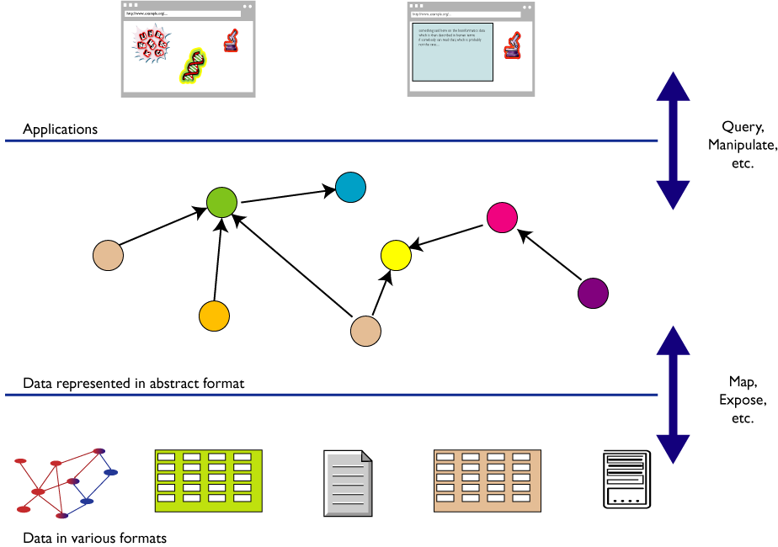
RDF as a common format for merging data
http://www.w3.org/2007/Talks/0221-Bangalore-IH/

Slide 6

Aggregating information about this book...

Slide 7
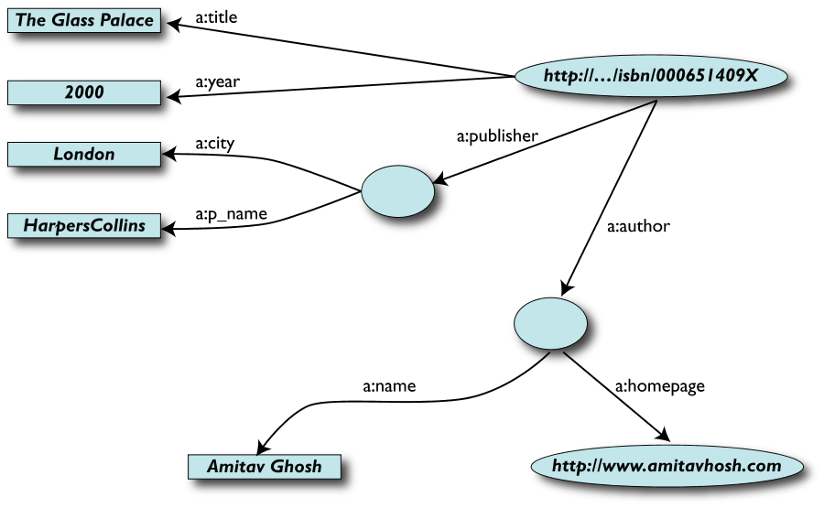
Given Data Source A
Source: Ivan Herman, http://www.w3.org/2007/Talks/0221-Bangalore-IH/

Slide 8
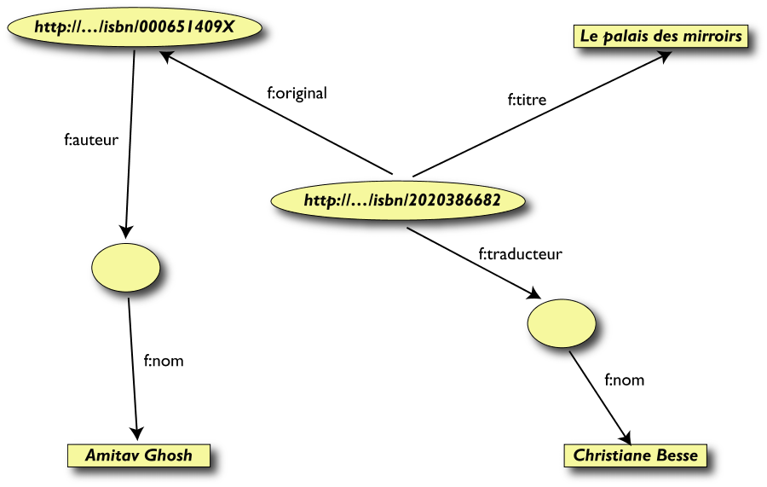
...and Data Source B
Source: Ivan Herman, http://www.w3.org/2007/Talks/0221-Bangalore-IH/

Slide 9
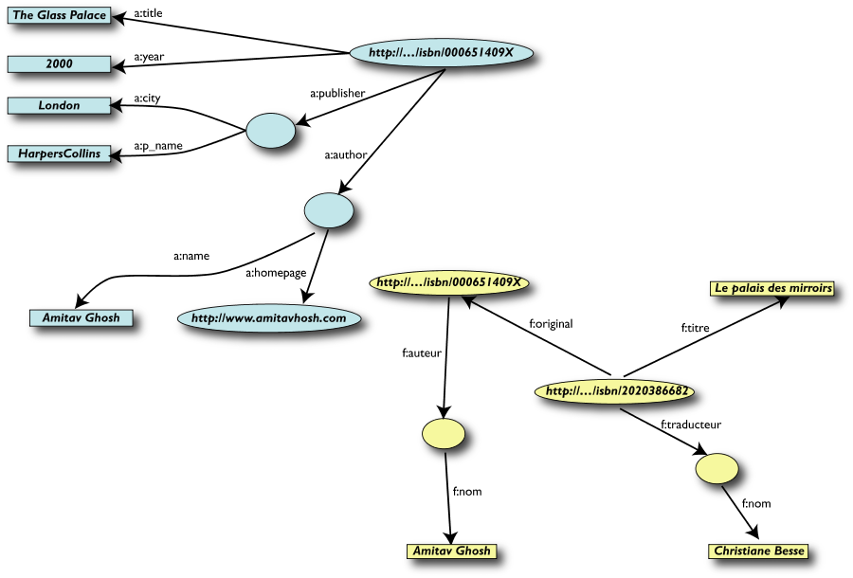
…aggregate A and B
Source: Ivan Herman, http://www.w3.org/2007/Talks/0221-Bangalore-IH/

Slide 10
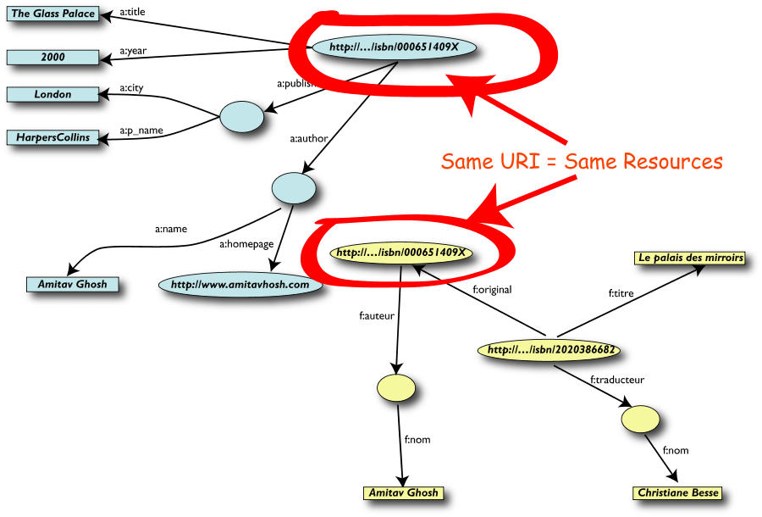
…matching URIs to create links automatically
Source: Ivan Herman, http://www.w3.org/2007/Talks/0221-Bangalore-IH/

Slide 11
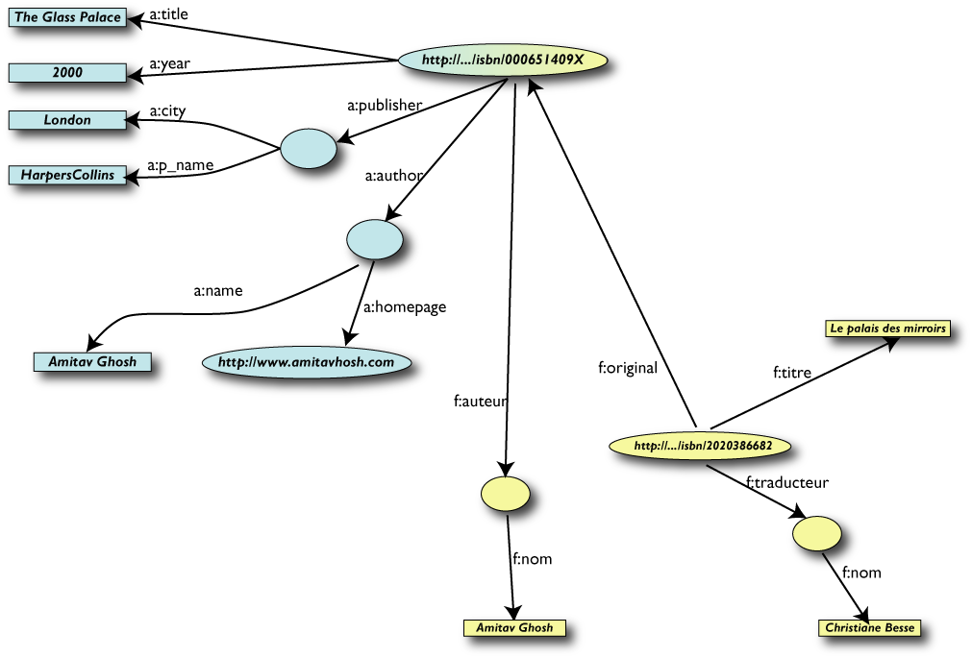
...like this
Source: Ivan Herman, http://www.w3.org/2007/Talks/0221-Bangalore-IH/

Slide 12
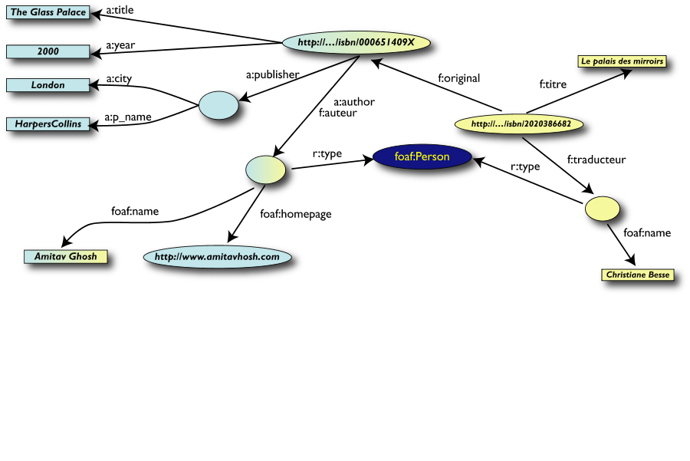
Add extra knowledge
Source: Ivan Herman, http://www.w3.org/2007/Talks/0221-Bangalore-IH/

Slide 13
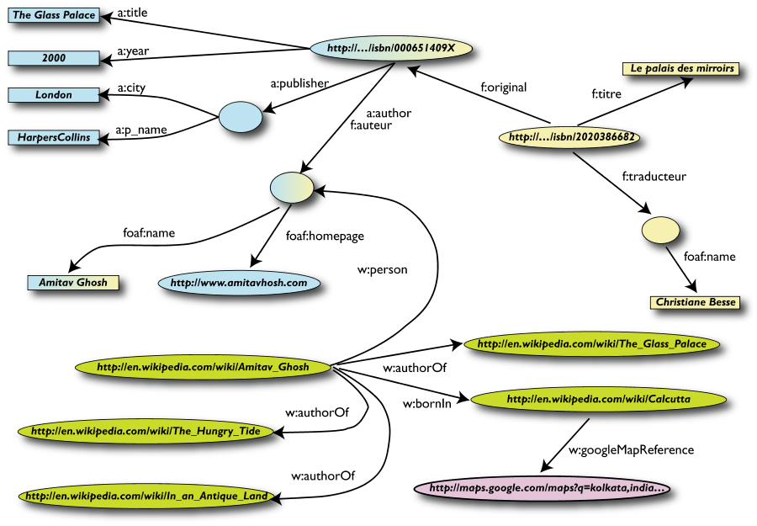
... or merge with Wikipedia data
Source: Ivan Herman, http://www.w3.org/2007/Talks/0221-Bangalore-IH/

Slide 14
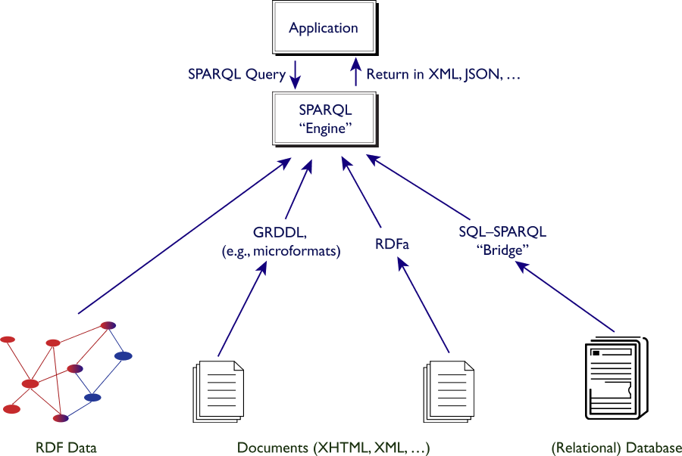
Merged data is queried with SPARQL
Queries are
expressed as
RDF triples
with unknown
variables.
Source: Ivan Herman, http://www.w3.org/2007/Talks/0221-Bangalore-IH/

Slide 15
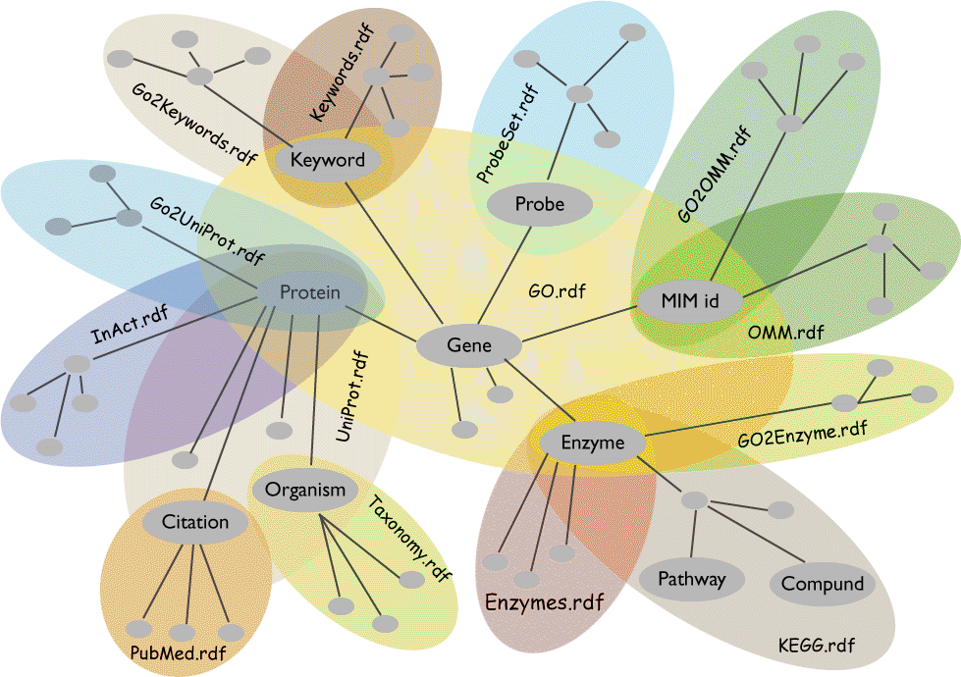
Finding things related to “genes” across databases
Source: Joanne Luciano, Mitre, and the W3C HCLS IG

Slide 16
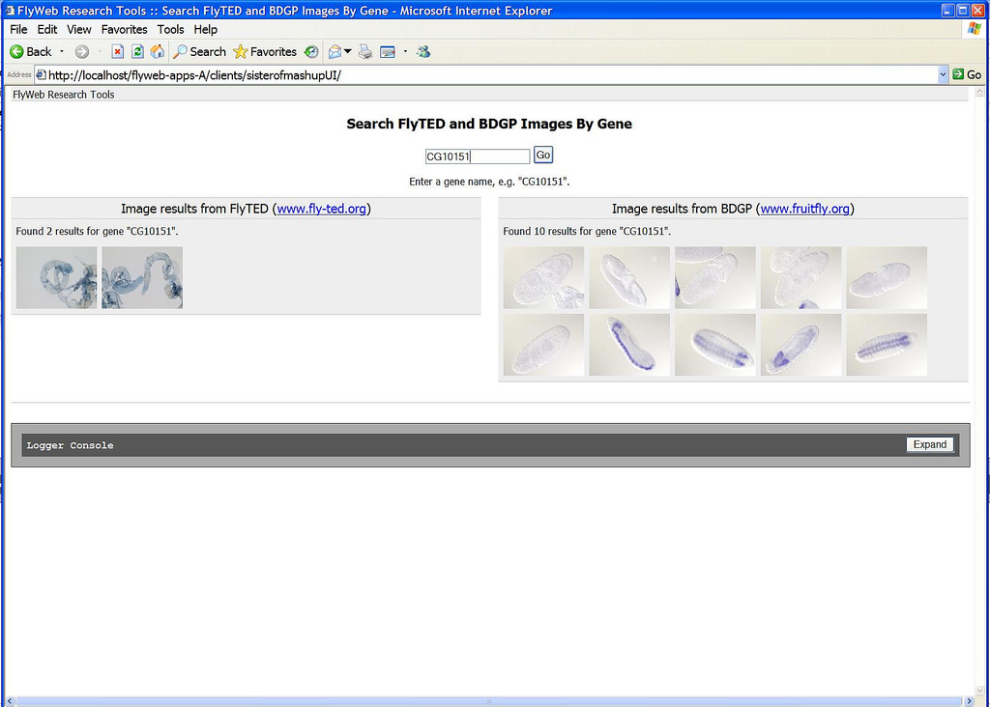
http://openflydata.org
[insert screenshot of mashup]
http://purl.org/net/aliman
16

Slide 17
Creating a Web of Data (Linked Data)
Value of information as function of what it links to (Tim Berners-Lee)‏
Four rules for maximizing “unplanned re-use”
1. Identify things with URIs.
2. Use HTTP URIs.
3. Serve information on the Web against the URIs.
4. Link related material.
http://www.w3.org/DesignIssues/LinkedData.html

Slide 18
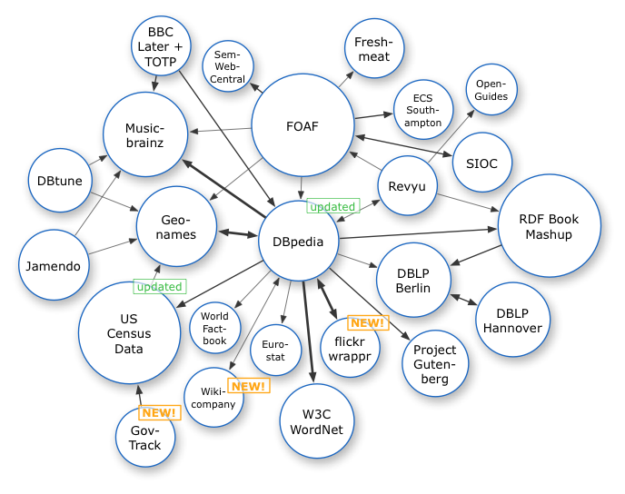
Linked Data Cloud, 2007
http://dbpedia.org

Slide 19
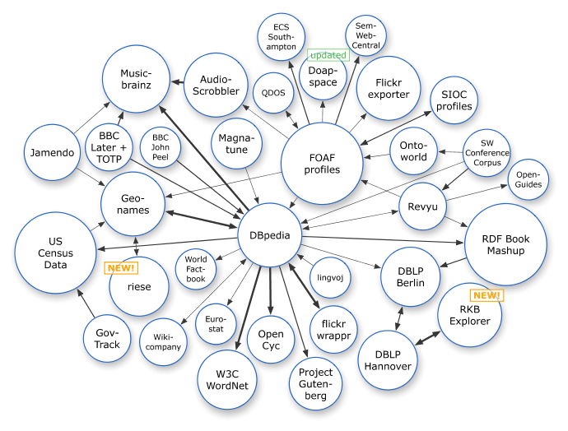
Linked Data Cloud, March 2008

Slide 20
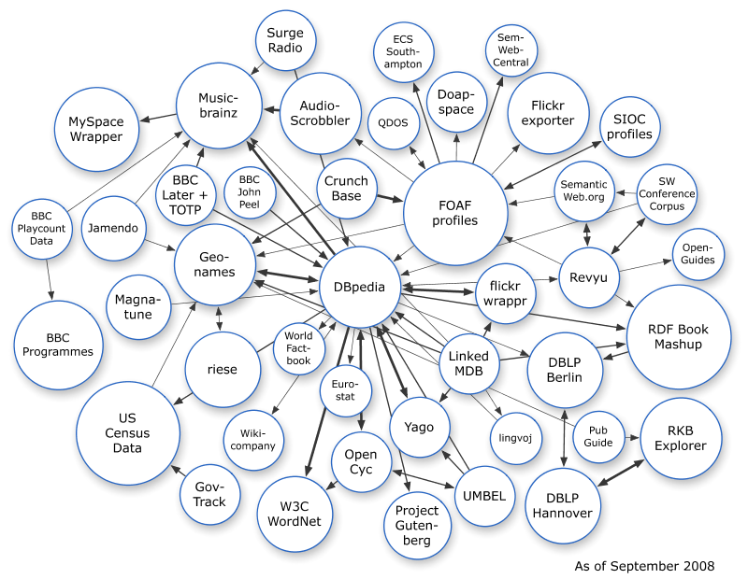
Linked Data Cloud, September 2008

Slide 21
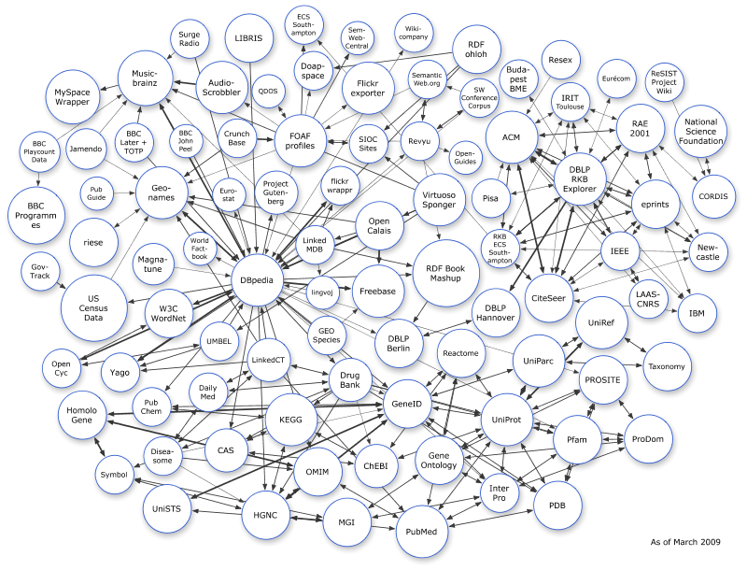
Linked Data Cloud, March 2009

Slide 22
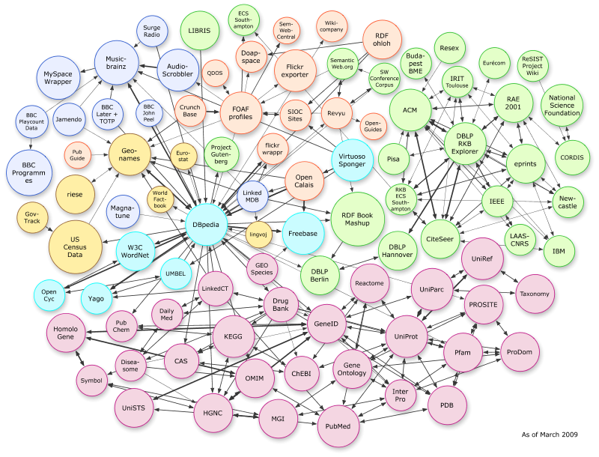
Application-specific parts of the cloud
“Bio”-related datasets
Thanks to “Linking Open Drug Data” task force of the HCLS at W3C

Slide 23
Embedded metadata and structured search

Slide 24
Extracting triples from Web pages
GRDDL (Gleaning Resource Descriptions from Dialects of Languages)‏
Mechanism for extracting structured data from XML and XHTML documents and converting that data (via an XSLT script) into RDF
RDFa (“RDF-in-attributes”)‏
Embeds RDF-structured data into Web pages
Extends XHTML with attributes for carrying RDF data
Data can be cut-and-paste between RDF-aware applications
Humans see a normal-looking Web page. Machines can download the embedded RDF data.
Microformats
Small XML formats to embed in Web pages
Work well for well-defined contact (hCard) or calendar (hCal) information, but fields not designed to be shared across formats
GRDDL can be used to extract RDF triples from Microformats

Slide 25
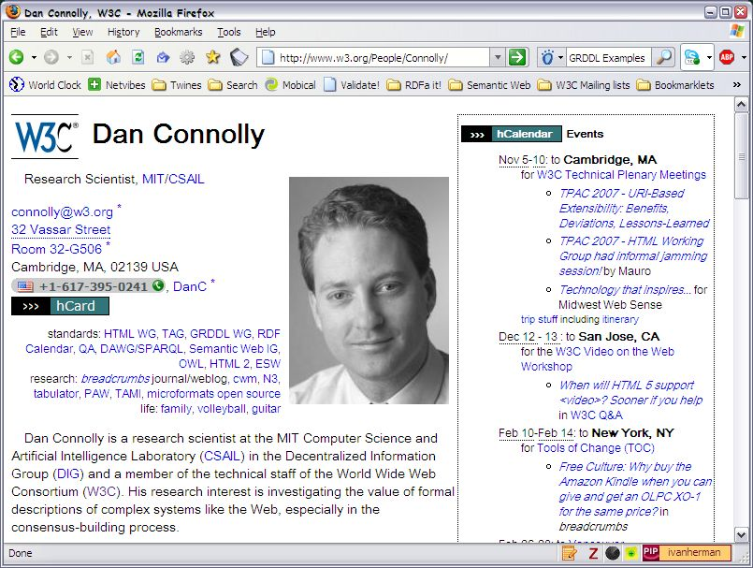
GRDDL transformation scripts…
Source: http://www.w3.org/2009/Talks/0615-SanJose-tutorial-IH/

Slide 26
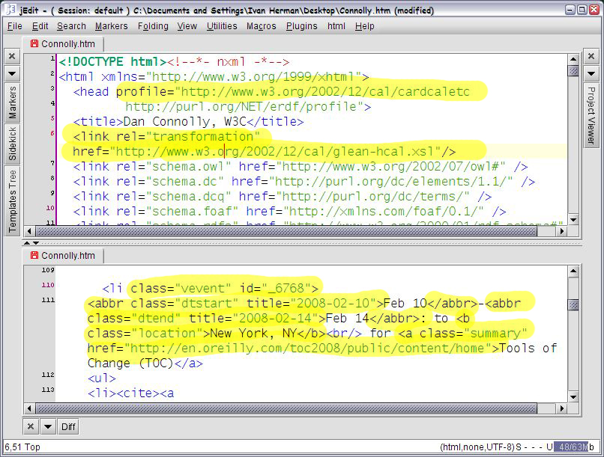
… behind the scenes …
Source: http://www.w3.org/2009/Talks/0615-SanJose-tutorial-IH/

Slide 27
…yielding, through the GRDDL transform
<http://www.w3.org/People/Connolly/#_6768>
a <http://www.w3.org/2002/12/cal/icaltzd#Vevent>;
<http://www.w3.org/2002/12/cal/icaltzd#organizer>
<http://www.w3.org/People/Connolly/#me>;
<http://www.w3.org/2002/12/cal/icaltzd#summary>
"Tools of Change (TOC)";
<http://www.w3.org/2002/12/cal/icaltzd#dtstart>
"2008-02-10"^^<http://www.w3.org/2001/XMLSchema#date>;
<http://www.w3.org/2002/12/cal/icaltzd#dtend>
"2008-02-14"^^<http://www.w3.org/2001/XMLSchema#date>;
<http://www.w3.org/2002/12/cal/icaltzd#url>
<http://www.w3.org/People/Connolly/#_6768>;
<http://www.w3.org/2002/12/cal/icaltzd#location>
"New York, NY" .
Source: http://www.w3.org/2009/Talks/0615-SanJose-tutorial-IH/

Slide 28
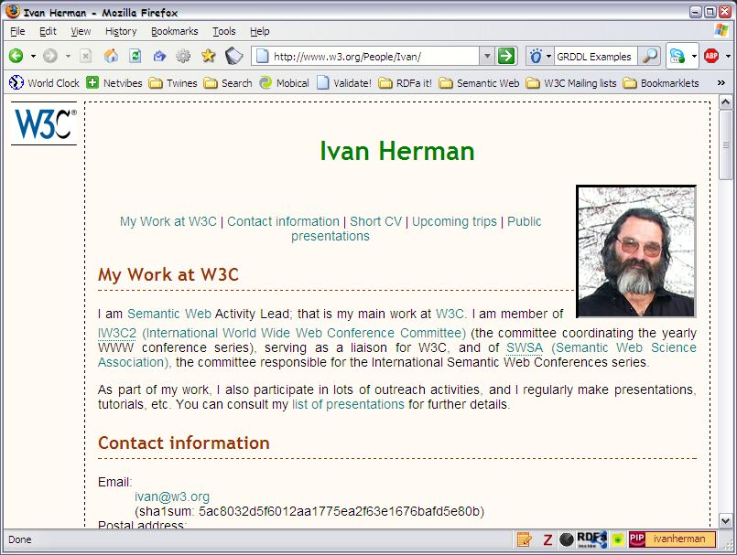
RDFa (RDF attributes) embedded in Web pages
Source: http://www.w3.org/2009/Talks/0615-SanJose-tutorial-IH/

Slide 29
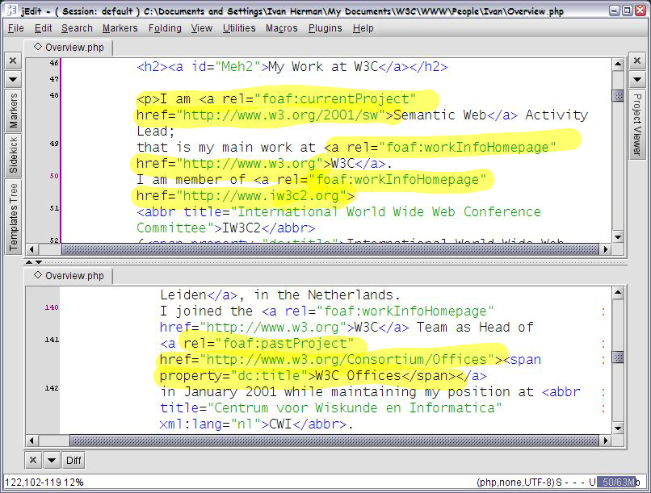
… behind the scenes …
Source: http://www.w3.org/2009/Talks/0615-SanJose-tutorial-IH/

Slide 30
…yielding, by extracting RDF from XHTML
<Overview.html#me> a foaf:Person;
foaf:currentProject <http://www.w3.org/2001/sw>;
foaf:workInfoHomepage
<http://www.iw3c2.org>,
<http://www.w3.org>;
foaf:pastProject
<http://www.w3.org/Consortium/Offices>;
...
<http://www.w3.org/Consortium/Offices> dc:title "W3C Offices".
Source: http://www.w3.org/2009/Talks/0615-SanJose-tutorial-IH/

Slide 31
Extracted data can be SPARQL-ed
SELECT DISTINCT ?name ?home ?orgRole ?orgName ?orgHome
# Get RDFa from my home page:
FROM <http://www.w3.org/People/Ivan/>
# GRDDL-ing http://www.w3.org/Member/Mail:
FROM <http://www.w3.org/Member/Mail/>
WHERE {
?foafPerson foaf:mbox ?mail;
foaf:homepage ?home.
?individual contact:mailbox ?mail;
contact:fullName ?name.
?orgUnit ?orgRole ?individual;
org:name ?orgName;
contact:homePage ?orgHome.
}
Source: http://www.w3.org/2009/Talks/0615-SanJose-tutorial-IH/
Notes:
Note that the SPARQL query:
- uses the same URI for the page and the RDF data (some processors, like Virtuoso or Tabulator) are capable of running the converters (well, Tabulator does not do it for RDFa yet)‏
- the query shows the data coming from different sources, (colour coded) with the ?mail term, sort of, 'binding' the data coming from different places. .Ie, the SPARQL query does the 'mash up' on the query level, regardless of the exact format the data is stored in...

Slide 32
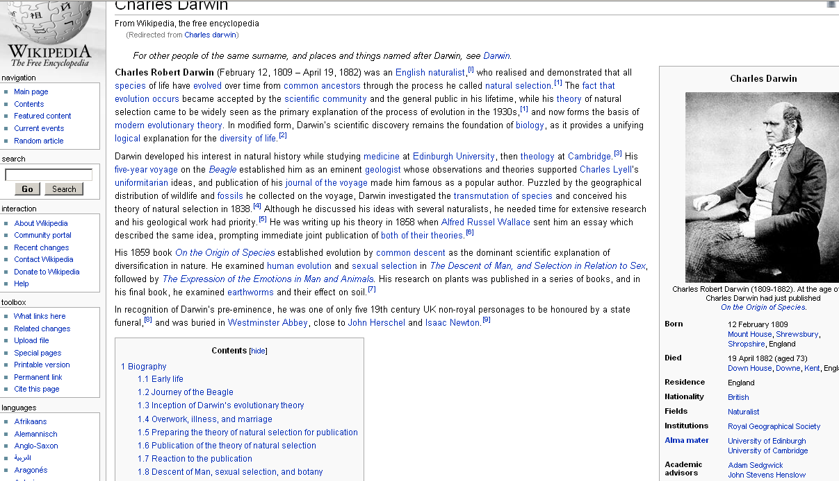
Extract data from Wikipedia infoboxes...

Slide 33
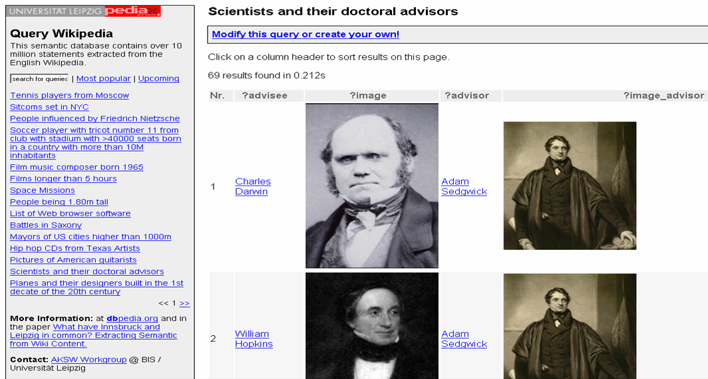
Query on merged data (example from DBPedia)

Slide 34
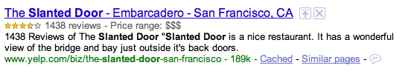
Commercial applications
Yahoo SearchMonkey and Google Rich Snippets
Harvest RDFa and microformat metadata from Web pages
Customized “enhanced display” of search results
Harvested data allows construction of specialized databases of products, people, places, events.

Slide 35
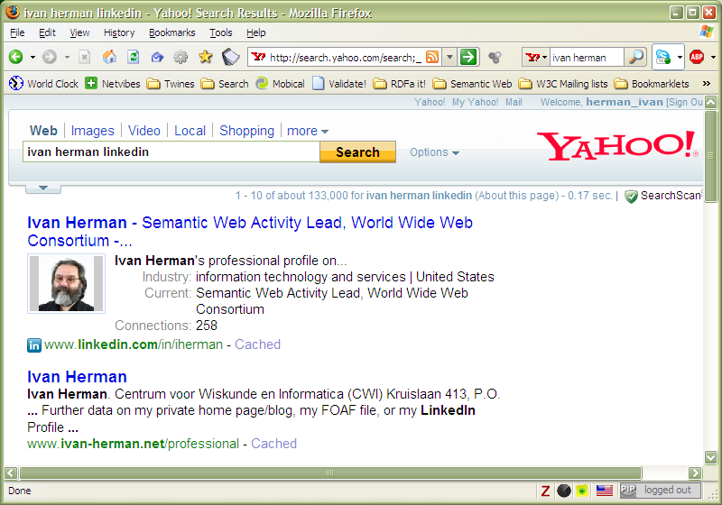
“Structured search” (example Yahoo)
Search based results may be customized via small applications
Metadata in pages (in RDFa, microformats etc) are reused
Metadata (embedded with RDFa or served via feeds) is collected by Slurp, Yahoo’s crawler
Search results are presented according to customized templates
Source: Peter Mika, Yahoo! Research, (SWEO Case Study)

Slide 36
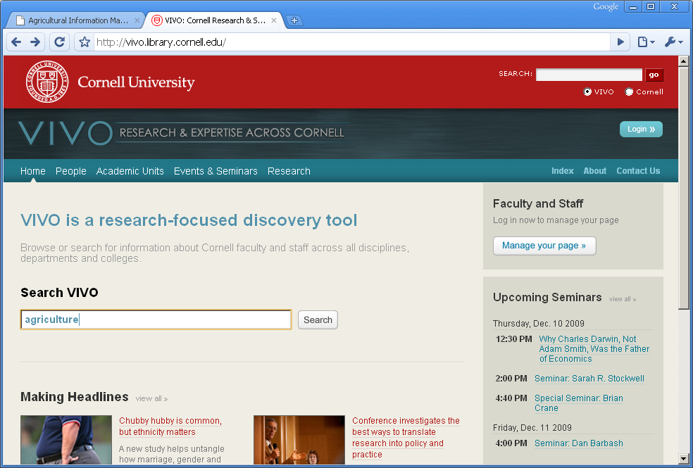
Start with “Google-like” query…

Slide 37
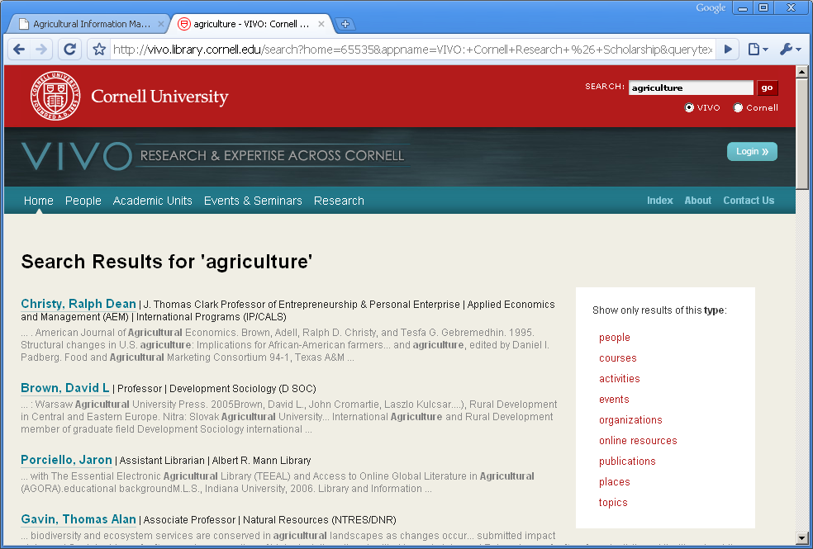
Results structured by type

Slide 38
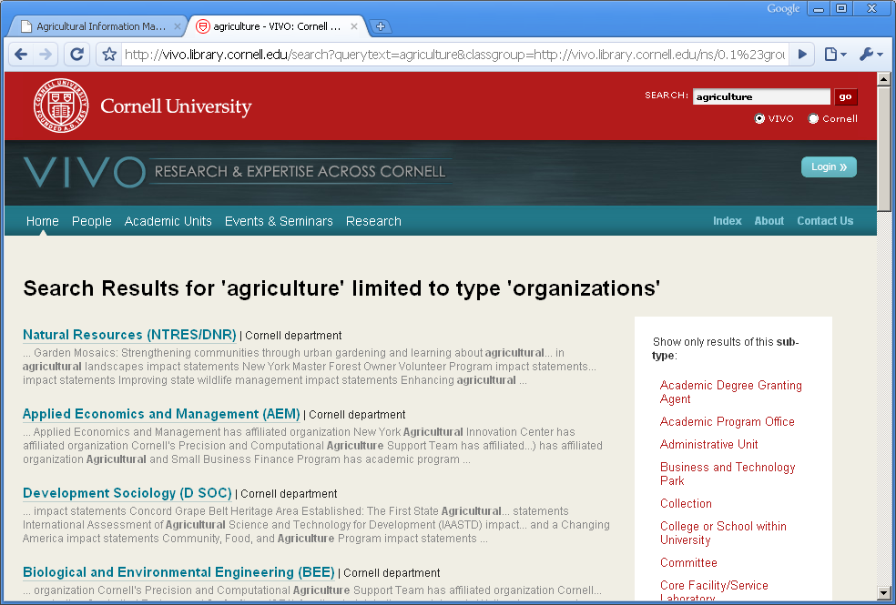
Focus in on a type

Slide 39
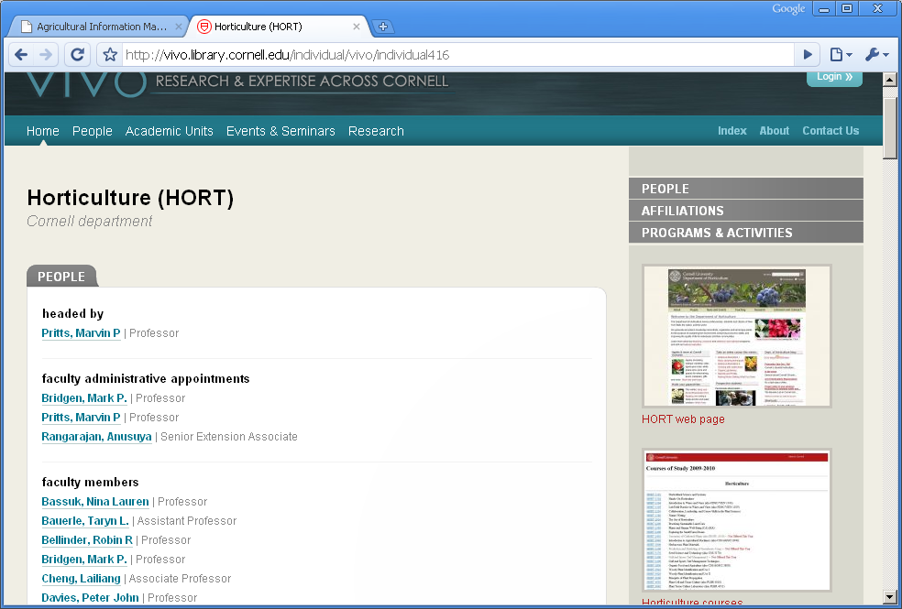
Explore from multiple angles

Slide 40
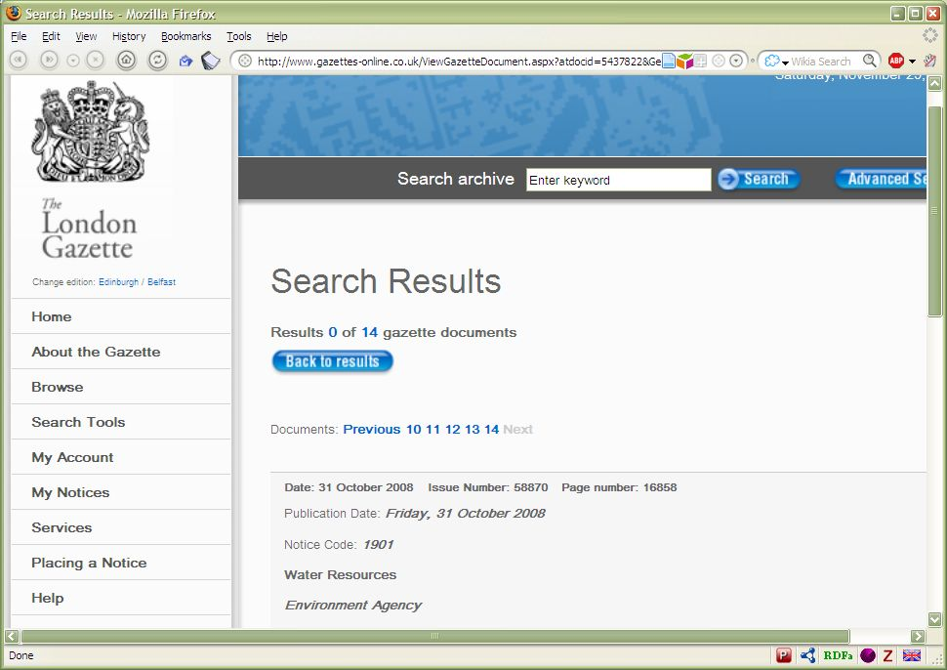
E-Government data

Slide 41
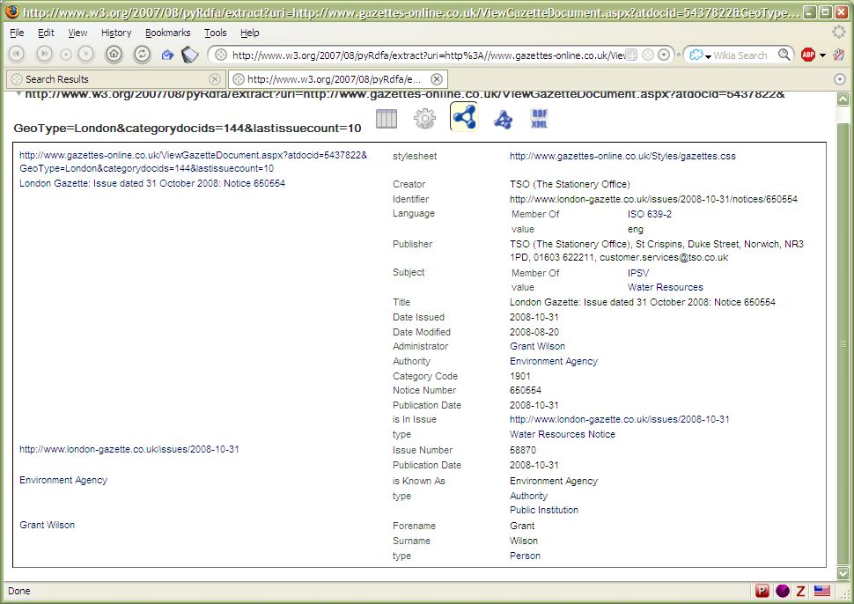
…under the hood, RDF…

Slide 42
Leveraging Content Management Systems
London Gazette – UK Office of Public Sector Information (OPSI)
“Approaches to exposing government data need to be both pragmatic and achievable, without requiring wholesale changes to existing IT infrastructure”.
Existing database-driven Websites can be “tweaked” to serve RDF data.
Some data is well-structured :lists of schools and hospitals, statistics…
Most data is semi-structured, with semantics embedded in free text.
Existing taxonomies of fish types or military vehicles need to be “Webified”

Slide 43
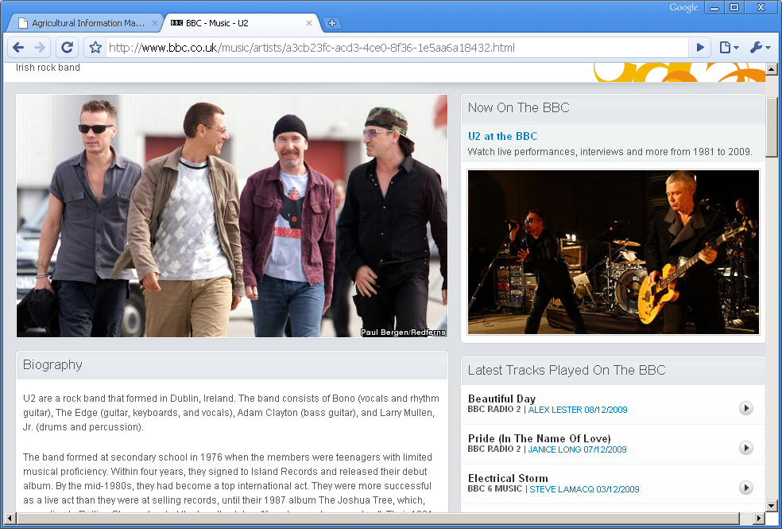
Mainstream media sites

Slide 44
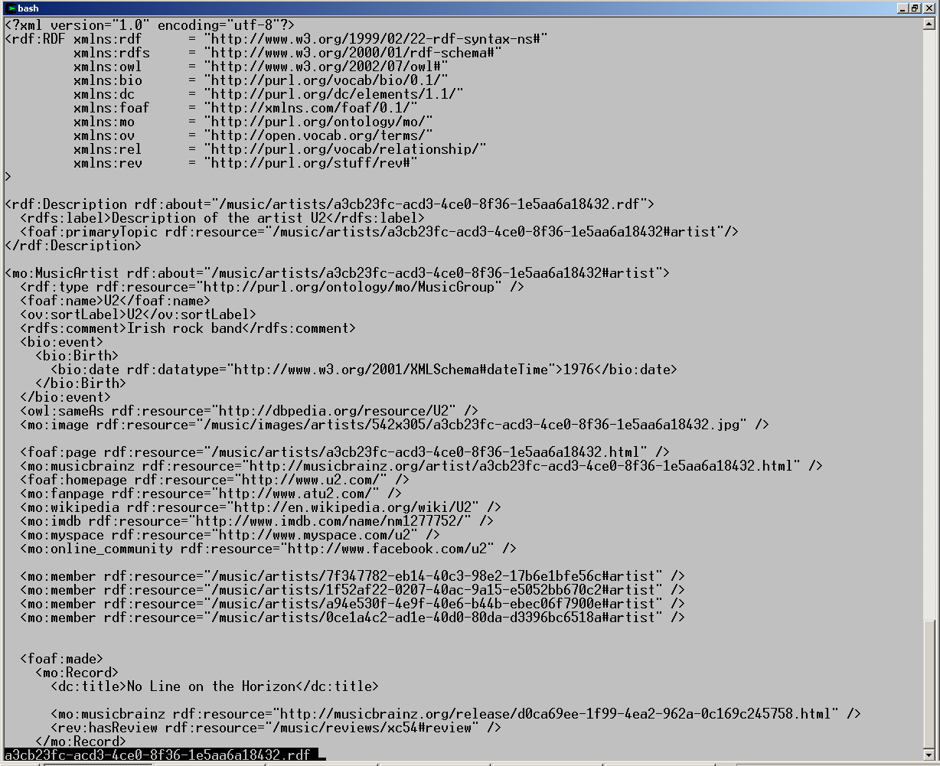
…under the hood, RDF…

Slide 45
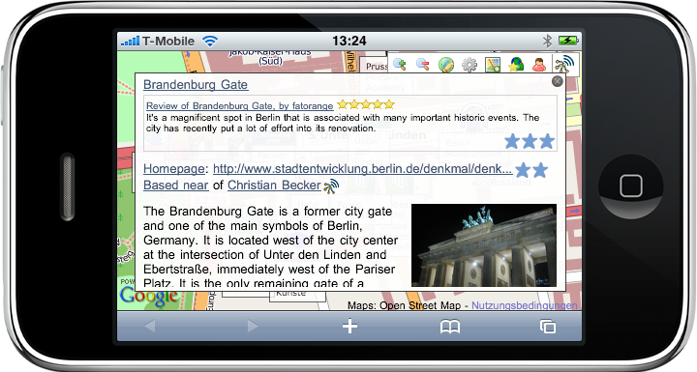
...maybe on your phone...
Source: Chris Bizer and Christian Becker, Freie Universität, Berlin

